Slide 1
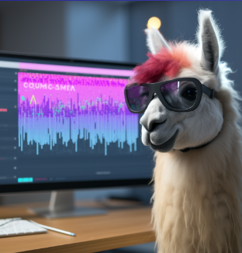
Team 18:
Llama Lingo - Use Case Presentation
Taylor Williams, Jonathan Woods, Jamie Wilkowski, Chance Galvin

Slide 2
Introduction

Slide 3
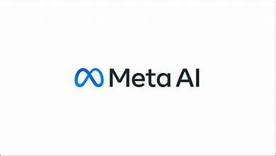

Goals and Objectives
This software project application aims to create a tool that uses artificial domain experts, like Chat GPT or Llama 2, to provide educational information on various topics.
The approach is bottom-up, starts with extreme analytics and fits them to a topic
The application will consist of artificial narrow intelligence (ANI) products specialized in specific topics, and these ANIs will analyze and store data related to their expertise.
Users can ask questions about a topic, and the application will provide answers based on the analyzed data.
The goal is to offer a pedagogical tool to help users explore topics through the expertise of these artificial experts, benefiting a wide range of users and fields.

Slide 4

Software Scope
Users and Contributors:
The users of this application include administrators and end users.
The end users (General users, students, employees, or hobbyists) will be able to acquire the information the application has to offer over a specific topic.
The administrators will have full access and control over the application’s content, having special privileges not available to regular users.
Processing Functionality:
The entire software project will be accessible via a web application.
Administrative information and data related to the application's specific topic will be stored in an Azure Cloud database storage account.
This stored information will be used to enable administrators to perform CRUD (Create, Read, Update, Delete) operations and provide valuable information to end users for learning purposes within the application.

Slide 5
Software Scope
Major Inputs:
Administrators can log in and access their administration panel, where they can perform CRUD operations on administrator information, as well as manage data in the application's storage account and parsed object dataset.
They can also make changes to branding and customization.
End users can input inquiries related to the specific topic of the application into the prompt.
Outputs:
The software project involves a user-friendly website application that provides interfaces for both administrators and end users.
Administrators have access to an admin panel with menu options, while end users can input questions through a user-friendly prompt to receive answers to their inquiries.

Slide 6

Software Context
What is Llama Lingo’s purpose?
Artificial intelligence (AI) is a popular field in computer science, and businesses and developers are using AI to create various applications.
One idea is to develop an educational software application using information from AI applications like ChatGPT and Llama 2.
This web app could serve students, employees, hobbyists, and general users by providing expert-level information on specific topics. For example, it could help new employees quickly learn about their job or provide environmentalists with the latest updates on climate change.
Llama Lingo is a pedagogical tool designed to benefit anyone interested in a particular topic.

Slide 7
Major Constraints
Time Constraint:
The project has a limited time frame of 8-9 months, which means not all proposed features can be implemented. An agile approach will involve time spent learning about integration with significant technologies.
Team Size:
Due to the small team of 4 members, some proposed functions may not be feasible to develop.
Security:
Administrative information must be protected from unauthorized access.
User Support:
The system should support user independence, privacy, and accessibility. User interfaces should be easy to understand, and users should be able to navigate the system without assistance from others.

Slide 8
Usage Scenario

Slide 9
User Profiles
There are two main user roles in the system:
Administration (Admin) - Full Control:
Role: Administrative staff or system administrators.
Responsibilities: Administrators have the highest level of access and control within the system. They can configure the system, manage users, oversee content, and coordinate artificial domain experts.
End User (User) - Read Only:
Role: General users, such as students, employees, or hobbyists.
Responsibilities: End users interact with the system for learning, training, or exploration purposes. They can use the system's functions to gain insights and get answers to their questions from artificial domain experts, but they do not have control over system settings.

Slide 10
User Stories
Administrator:
As an administrator, I want to be able to manage the system. I want to have access to CRUD (Create, Read, Update, Delete) functionalities for parsed objects, locations, brands, and users within the system. I want to contribute to the system by adding knowledge and expertise about a topic.
End User:
As an end user, I want to explore various topics using the system’s artificial domain experts to gain deeper insights and knowledge.

Slide 11
Special Usage Considerations
Different Devices or Screen Sizes:
Some users may be using devices with small screens or limited display capabilities. Ensure that the user interface remains functional and legible on various screen sizes and devices.
User Requires Assistance with Accessibility:
If a user requires accessibility features due to visual, auditory, or motor impairments, the system may need adjustable fonts, screen reader compatibility, and keyboard shortcuts.

Slide 12
Use Case Descriptions
Use Case 1: Admin Menu Login Process
ID: | UC1-ADMN-01
Title: | Admin Menu Login
Description: | This use case involves the administrator logging into and accessing the admin menu.
Primary Actor: | Admin
Preconditions: | The administrator must be logged out of the admin panel.
Postconditions: | The administrator is logged into the admin panel.
Main Success Scenario: | The administrator is logged out. The administrator logs in to the admin panel. The admin menu is displayed with various options.
Extensions: | Administrator is unable to login because they did not input the correct login information The inputted information could not be found in the database under the administrator table
Frequency of Use: | Regularly
Status: | Active
Owner: | TBD
Priority: | High

Slide 13
Use Case 2: Admin Menu Branding
ID: | UC1-ADMN-02
Title: | Admin Registration Login Branding
Description: | This use case involves the branding and customization of pages through the admin menu.
Primary Actor: | Administrator
Preconditions: | The administrator must be logged into the admin panel.
Postconditions: | Visuals of selected pages are customized as per the administrator's choices.
Main Success Scenario: | Administrator logs in to the admin panel. Navigates to the branding and customization section. Selects branding options Logo Colors Text Applies the selected branding to the selected pages.
Extensions: | Exceptions: The administrator is unable to correctly process branding and customization CRUD due to functional error
Frequency of Use: | Regularly
Status: | Active
Owner: | TBD
Priority: | Medium

Slide 14
Use Case 3: Admin POD CRUD (Parsed Object Dataset)
ID: | UC1-ADMN-03
Title: | Admin POD CRUD (Parsed Object Dataset)
Description: | This use case involves the administrator performing CRUD (Create, Read, Update, Delete) operations on Parsed Object Datasets.
Primary Actor: | Administrator
Preconditions: | The administrator must be logged into the admin panel.
Postconditions: | The specified CRUD operation on the Parsed Object Dataset is successfully executed.
Main Success Scenario: | Administrator logs in to the admin panel. Navigates to the Parsed Object Dataset management section. Selects the desired operation Create() Read() Update() Delete() Provides necessary input or selects a dataset. The system performs the CRUD operation on the dataset.
Extensions: | Exceptions: The administrator is unable to correctly process POD CRUD operations due to functional error
Frequency of Use: | Regularly
Status: | Active
Owner: | TBD
Priority: | Medium

Slide 15
Use Case 4: Admin Location CRUD (Storage Account)
ID: | UC1-ADMN-04
Title: | Admin Location CRUD (Storage Account)
Description: | This use case involves the administrator performing CRUD operations on Storage Locations (Storage Accounts).
Primary Actor: | Administrator
Preconditions: | The administrator must be logged into the admin panel.
Postconditions: | The specified CRUD operation on the Storage Location is successfully executed.
Main Success Scenario: | Administrator logs in to the admin panel. Navigates to the Storage Location management section. Selects a Storage Location. Selects the desired operation: Create() Read() Update() Delete() The system performs the chosen CRUD operation on the Storage Location.
Extensions: | Exceptions: The administrator is unable to correctly process location CRUD operations due to functional error
Frequency of Use: | Regularly
Status: | Active
Owner: | TBD
Priority: | High

Slide 16
Use Case 5: End User Inputs Inquiry
ID: | UC1-EndUser-05
Title: | End User Inputs Inquiry
Description: | An end-user of the application enters a question/concern related to the application’s specific topic for information.
Primary Actor: | End User
Preconditions: | End User must be within the application’s website and has written and submitted an inquiry within the “question” prompt.
Postconditions: | The end user will receive an answer from the application.
Main Success Scenario: | The user will navigate and enter the application, “Llama Lingo” The user enters a question/concern they have related to Llama Lingo’s topic into the question prompt The user can submit their question/concern to the application for analysis
Extensions: | Exception: When the user inputs a question/concern unrelated to the application’s topic
Frequency of Use: | Regularly
Status: | Active
Owner: | TBD
Priority: | High

Slide 17
Use Case 6: End User Receives Inquire Result
ID: | UC1-EndUser-06
Title: | End user receives the Inquiry result
Description: | An end-user has entered a question/concern into the application’s question prompt and will receive a relevant answer.
Primary Actor: | End User
Preconditions: | The user has entered the application’s website and has submitted an inquiry related to the application’s topic.
Postconditions: | The end user will be able to receive/view the answer to their inquiry
Main Success Scenario: | The user will navigate and enter the application, “Llama Lingo” The user enters a question/concern they have related to Llama Lingo’s topic The user receives an answer to their question and learns new information from the application
Extensions: | Exception: The application is unable to give a relevant answer to the end user’s question/concern because they did not input a question/concern related to the application’s topic
Frequency of Use: | Regularly
Status: | Active
Owner: | TBD
Priority: | High

Slide 18
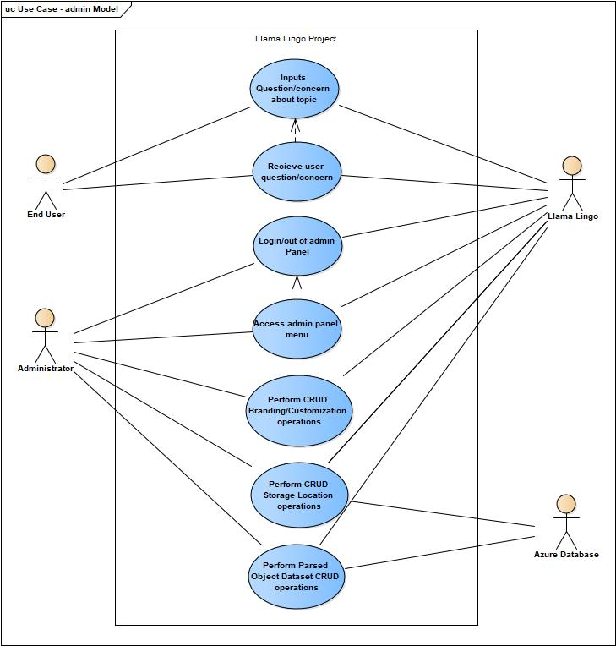
Use Case Diagram

Slide 19
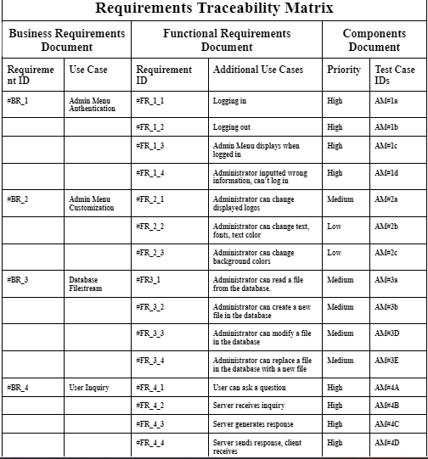
System Traceability Matrix

Slide 20
Supplementary Information (References)
R.S. Pressman & Associates, Inc.., www.rspa.com/docs/index.html. Accessed 3 Oct. 2023.
Ravi Bandakkanavar: A Techie, et al. “Software Requirements Specification Document with Example.” Krazytech, 17 Oct. 2019, https://krazytech.com/projects/sample-software-requirements-specificationsrs-report-airline-database/amp. Accessed 3 Oct. 2023.
“Software Requirements Specification (SRS) Project X 1 Introduction.” Studylib.net, https://studylib.net/doc/15699636/software-requirements-specification--srs--project-x-1--in. Accessed 3 Oct. 2023.

